Slide 1
🏦
96.72%
Random Forest Accuracy
Smart Loan
Approval System
4,269
Dataset Records
13
Dataset Columns
Machine Learning Project • CBP Final Presentation
Predict whether a loan application should be Approved or Rejected using applicant profile, CIBIL score, income, loan amount, and asset details.
0
Missing Values
Presented by: Satyam (24SCSE1040335) & Saurabh Kumar Singh (24SCSE1040340)
1

Slide 2
CBP Details
Smart Loan Approval System
Project identity and basic implementation information
Group Members
Satyam (24SCSE1040335)
Saurabh Kumar Singh (24SCSE1040340)
Project Title
Smart Loan Approval System using Machine Learning
Dataset URL
Kaggle: Loan-Approval-Prediction-Dataset
https://www.kaggle.com/datasets/architsharma01/loan-approval-prediction-dataset
Development Platform
Google Colab / Jupyter Notebook, Python, Pandas, Scikit-learn, Matplotlib, Seaborn
Deployment Platform
Streamlit Web App + local/online deployment using saved .pkl model files
Final Output: ML model + Normalizer + Streamlit UI for user-friendly prediction
2

Slide 3
Problem Definition & Objectives
Smart Loan Approval System
Why this project is useful
Problem Definition
Project Objectives
Banks receive many loan applications. Manual checking can be slow, inconsistent, and time-consuming. The project predicts loan status using customer financial data and credit score.
Build a supervised ML classification model
Predict Approved / Rejected loan status
Compare Logistic Regression and Random Forest
Deploy model through a simple Streamlit interface
Input Data → Data Cleaning → Model Training → Evaluation → Streamlit Deployment
3

Slide 4
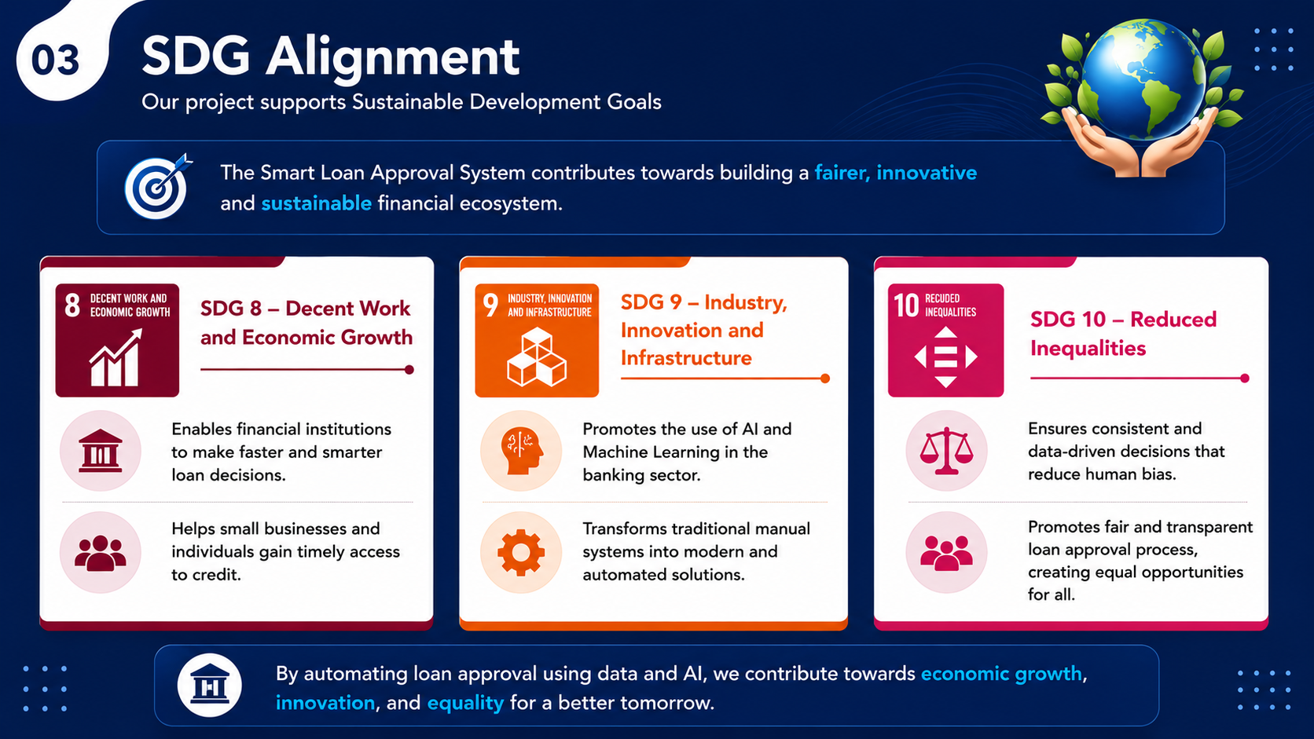

Slide 5
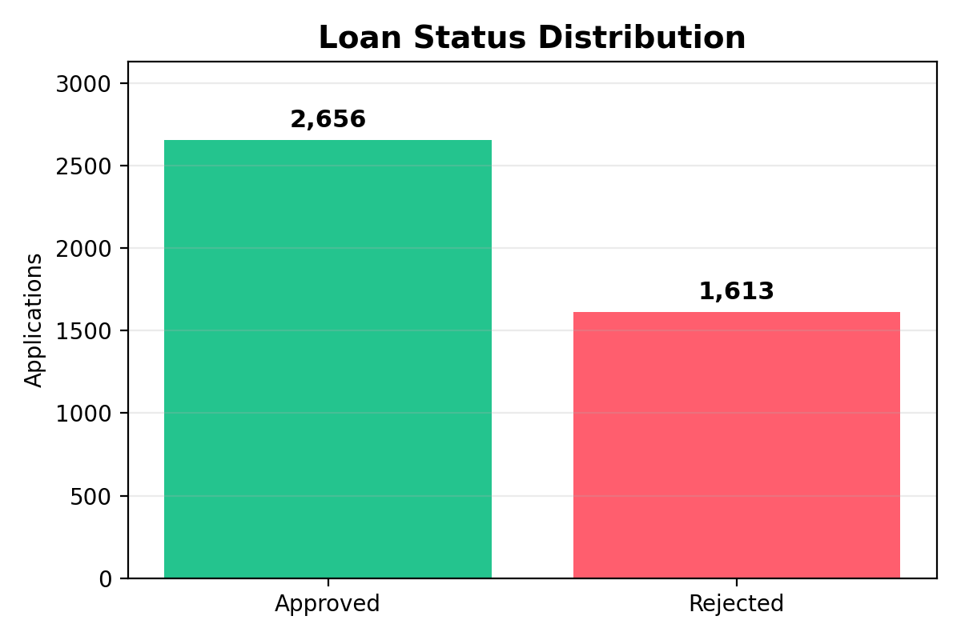
Dataset Overview
Smart Loan Approval System
Loan Approval Prediction dataset used for binary classification
4,269
Rows
13
Columns
2,656
Approved
1,613
Rejected
0
Null Values
Important Features
• Number of dependents
• Education and self-employment
• Annual income and loan amount
• Loan term and CIBIL score
• Residential, commercial, luxury, and bank assets
4

Slide 6
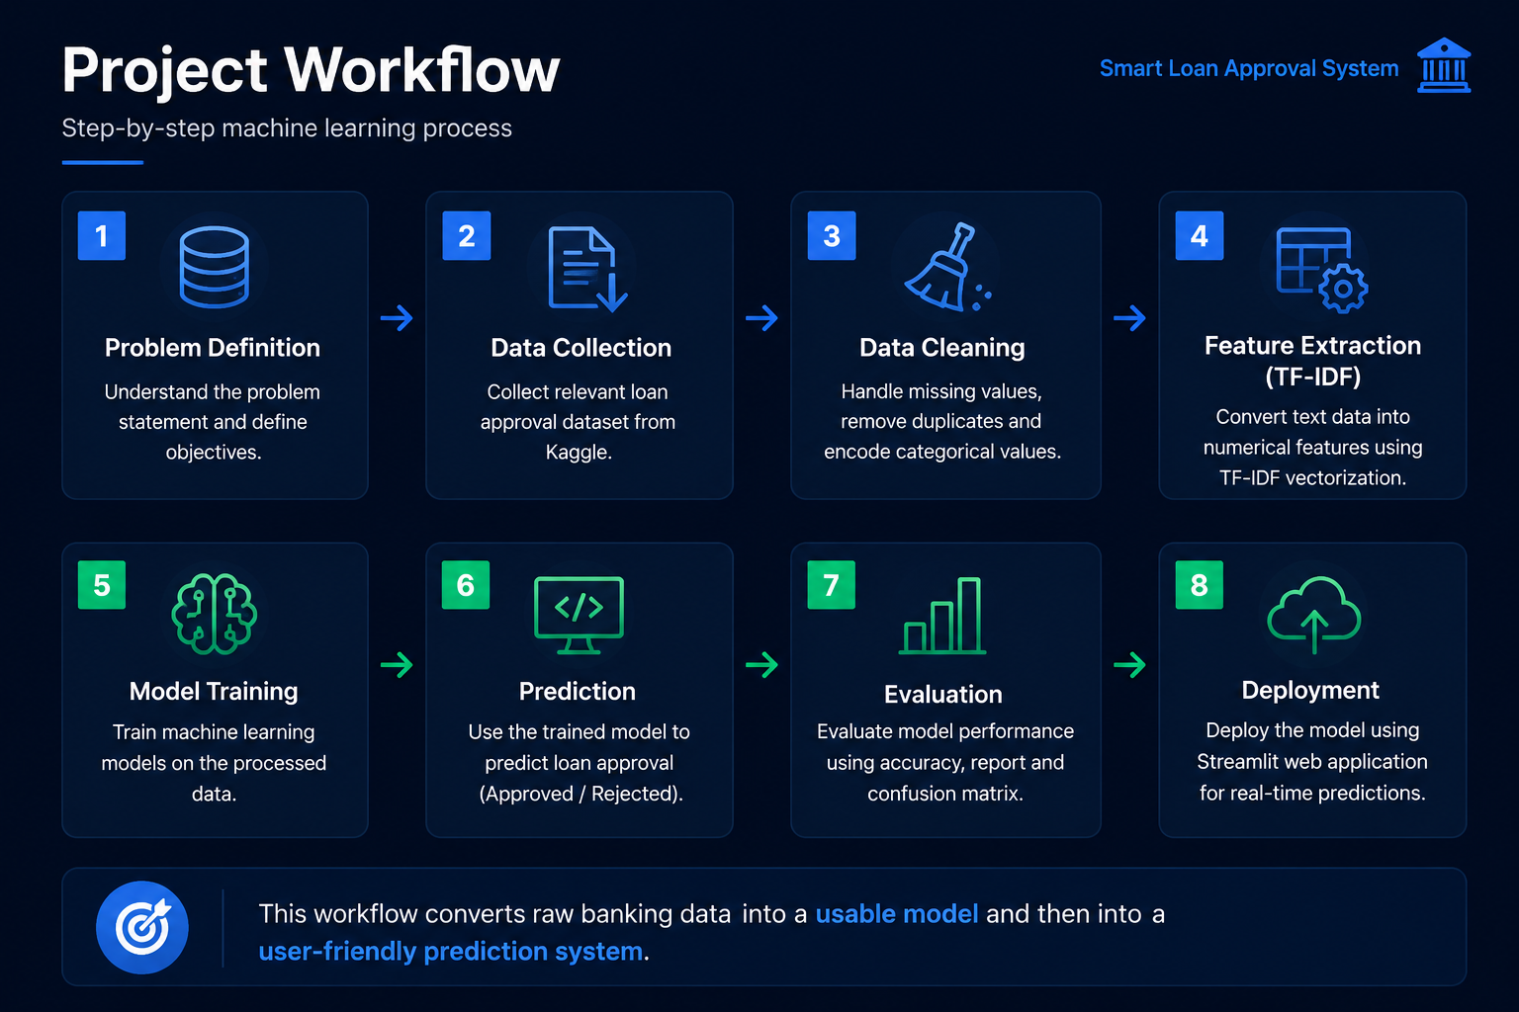

Slide 7
Smart Loan Approval System
Step-by-step machine learning process
1
Load Data
CSV dataset imported in Google Colab
2
Preprocess
Drop loan_id, encode categorical values
3
Split & Scale
80:20 train-test split and MinMax scaling
4
Train Models
Logistic Regression and Random Forest
5
Evaluate
Accuracy, report, confusion matrix
6
Deploy
Pickle files used in Streamlit app
This workflow converts raw banking data into a usable model and then into a user-friendly prediction system.
5

Slide 8
Data Preparation
Smart Loan Approval System
Cleaning and transformation performed before training
1. Data Inspection
Used head(), info(), shape, columns, value_counts(), and null checks to understand the dataset.
2. Column Selection
Dropped loan_id because it is only an identifier and does not help prediction.
3. Encoding
Converted education, self_employed, and loan_status into numeric values using LabelEncoder.
4. Feature Split
X contains all input columns; y contains target column loan_status.
5. Train-Test Split
Used 80% training data and 20% testing data with random_state = 42.
6. Normalization
Used MinMaxScaler to bring numerical features into a 0 to 1 range.
Data preparation improves model performance and makes all features comparable during training.
6

Slide 9
Model Engineering
Smart Loan Approval System
Algorithms used in the project
Logistic Regression
Random Forest Classifier
Simple and interpretable baseline model for binary classification. It finds a decision boundary between Approved and Rejected classes.
Ensemble model using multiple decision trees. It handles non-linear relationships and performed best in this project.
Accuracy: 91.22%
Accuracy: 96.72%
Final model selected: Random Forest because it gave higher testing accuracy and better classification performance.
7

Slide 10
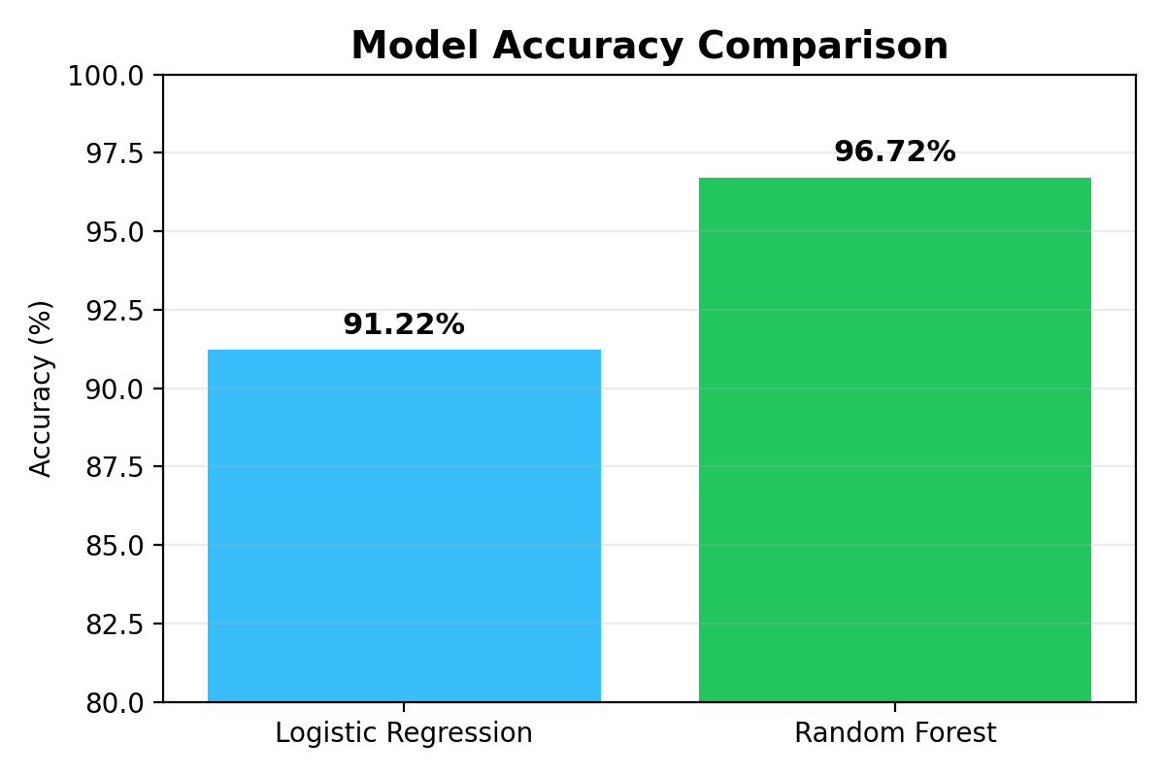
Model Evaluation
Smart Loan Approval System
Performance comparison on testing data
Evaluation Metrics Used
Accuracy Score: overall correct predictions
Classification Report: precision, recall, F1-score
Confusion Matrix: actual vs predicted classes
Feature Importance: contribution of each input feature
Result: Random Forest outperformed Logistic Regression and became the final deployed model.
8

Slide 11
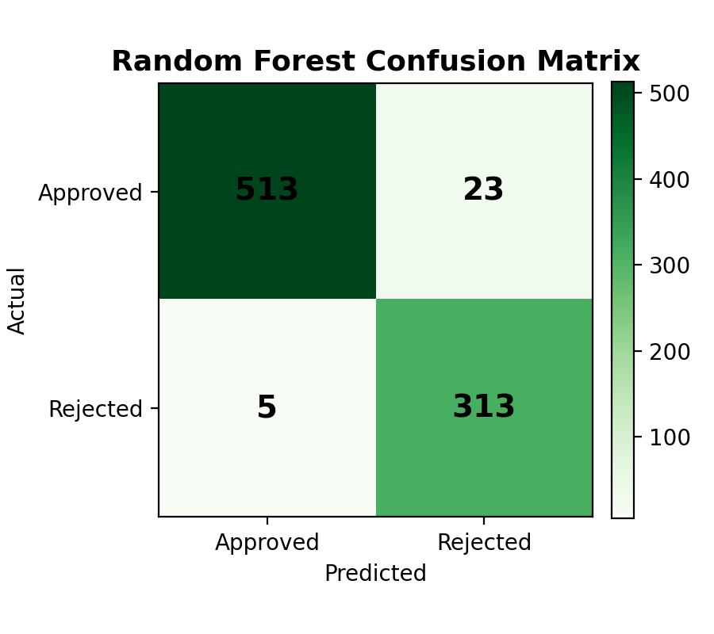
Random Forest Confusion Matrix
Smart Loan Approval System
Actual vs predicted result breakdown
Testing Set Result
513
Actual Approved correctly predicted
313
Actual Rejected correctly predicted
23
Approved predicted as Rejected
5
Rejected predicted as Approved
Interpretation: The model makes very few mistakes on the testing data, especially for rejected loan cases.
9

Slide 12
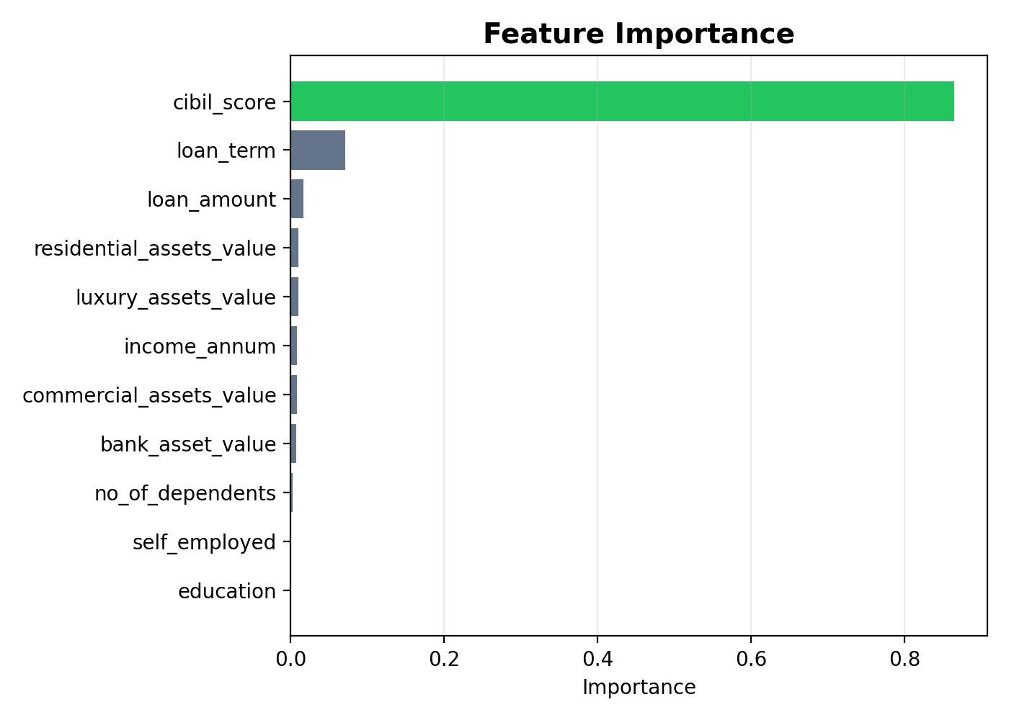
Feature Importance Analysis
Smart Loan Approval System
Which factors influence loan approval the most
Key Insight
CIBIL score is the most important feature in the model. Loan term and loan amount are also meaningful factors, while education and self-employment have lower importance in this dataset.
Business Meaning: Credit score is a strong indicator of repayment reliability, so it heavily impacts loan approval decisions.
10

Slide 13
Deployment Platform: Streamlit
Smart Loan Approval System
Turning the trained model into a usable interface
Streamlit App Components
🏦 Smart Loan Approval System
Loads loan_approval_model.pkl and normalizer.pkl
Takes user input through sliders and number fields
Applies same normalization as training stage
Predicts Approved or Rejected instantly
Adds banking validation rules for CIBIL score and high-risk loan amount
Number of Dependents ●●●
Annual Income ₹ 5,00,000
Loan Amount ₹ 3,00,000
Loan Term 5 Years
CIBIL Score 750
Education: Graduate Self Employed: No
Residential Assets: ₹ 2,00,000
Bank Assets: ₹ 1,50,000
✅ Loan Approved
11

Slide 14
Role of Each Member
Smart Loan Approval System
Team contribution across project phases
Problem definition & Planning
Satyam + Saurabh
Defined objective, selected project idea, planned workflow
Data Preparation
Satyam
Loaded dataset, cleaned columns, encoded data, split features/target
Model Engineering
Saurabh
Built Logistic Regression and Random Forest models
Model Evaluation
Saurabh
Checked accuracy, classification report, confusion matrix, feature importance
Model Deployment
Satyam
Created Streamlit UI, loaded pickle model and normalizer
Monitoring & Maintenance
Satyam + Saurabh
Tested predictions, checked validation rules, planned future updates
12

Slide 15
Benefits & Use Cases
Smart Loan Approval System
How people can use this project
For Banks
Helps in faster preliminary screening of loan applications and reduces manual workload.
For Customers
Provides quick feedback on whether a loan application may be approved or rejected.
For Students
Shows a complete ML workflow from data loading to model deployment.
For Decision Support
Can support banking officers by highlighting important factors like CIBIL score and loan amount.
For Automation
Streamlit interface makes predictions easy without writing code every time.
For Future Expansion
Can be improved with more data, cloud deployment, authentication, and monitoring dashboard.
Note: This system is a decision-support tool, not a replacement for final human banking approval.
13

Slide 16
Conclusion & Future Scope
Smart Loan Approval System
Final summary of the project
Conclusion
Future Scope
Built a complete loan approval prediction pipeline
Random Forest achieved 96.72% test accuracy
CIBIL score was the strongest influencing feature
Streamlit deployment made the model easy to use
Add cross-validation and hyperparameter tuning
Deploy on Streamlit Cloud / Render / Hugging Face Spaces
Add login system and admin dashboard
Collect new data and monitor model performance over time
Thank You
Questions?
14

